Slide 1
Detroit Housing
for the Future Fund
WebEx Presentation
September 10, 2021
Session will begin at 9:00am

Slide 2
Detroit Housing
for the Future Fund
WebEx Presentation
September 10, 2021

Slide 3
Panelists
Victor Abla, LISC Regional Preservation Director
Brandon Ivory, DHFF Program Officer, LISC
Keegan C. Mahoney, Program Director, Policy & Implementation Div., Housing & Revitalization Dept.

Slide 4
Housekeeping
All participants are muted upon entry
Use the chat box function to ask questions during the presentation
There will be time at the end of the presentation to answer questions as well
This webinar will be repeated and archived on the Detroit Housing for the Future Fund website—www.detroithousingforthefuturefund.org
Slides will be available for download from website

Slide 5
Agenda for Detroit Housing for the Future Fund presentation
How did we get here?
Overview of the Detroit Housing for the Future Fund (DHFF)
Highlights through August 2021
Review of Eligible Project Types
Loan Product Review
Preferred Equity Review
Required Documentation for Review

Slide 6
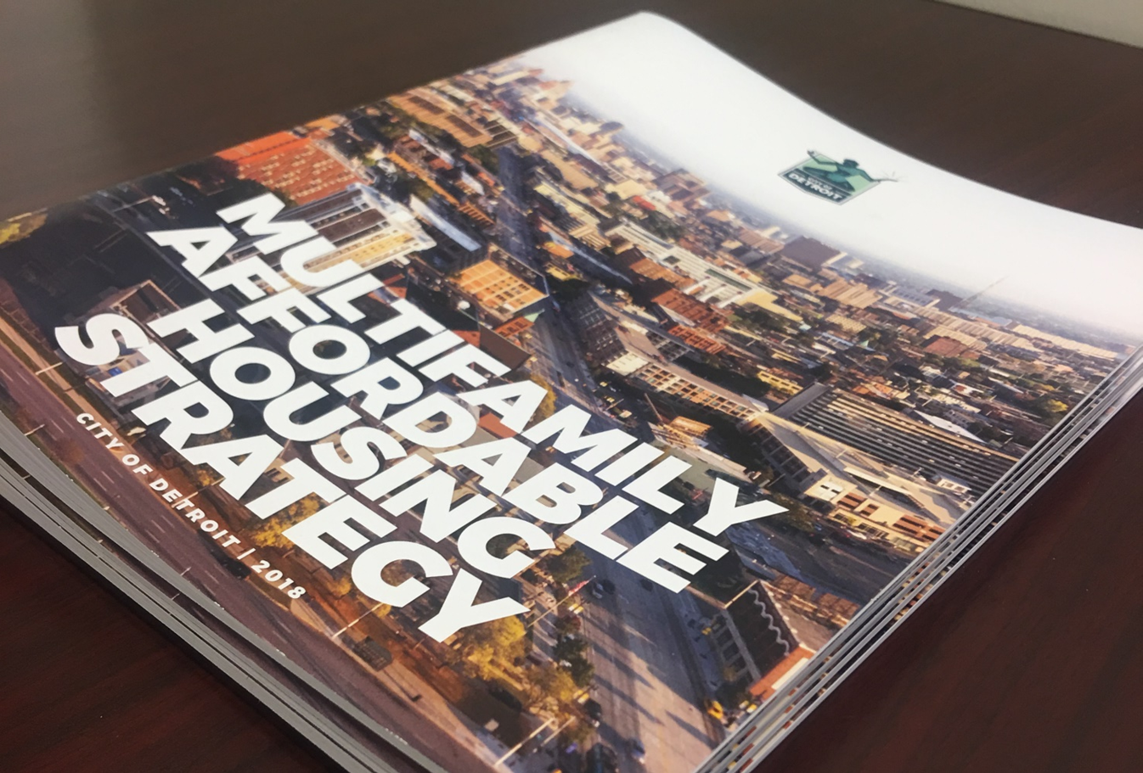
Multi-Family Housing Strategy
ESTABLISHED GOALS
Established the Detroit Housing for the Future Fund
Preserve 10,000 units and develop 2,000 units of affordable housing
Identified policies to achieve goals
Notes:
RL

Slide 7
What is the Detroit Housing for the Future Fund?
The Detroit Housing for the Future Fund (DHFF) publically launched in September of 2020 as a new fund comprised of private investment to be invested into affordable housing development and preservation in Detroit. The DHFF is managed by Local Initiatives Support Corporation and was created in partnership with the City of Detroit as part of the Affordable Housing Leverage Fund initiative. The DHFF is designed to deploy private grant and low interest loan capital to compliment and leverage public investment through the City of Detroit and Michigan State Housing Development Authority as well as tax credits and other existing affordable housing finance tools.

Slide 8
YTD Accomplishments
Five deals closed
New Construction
Acquisition Rehab
Preservation of Regulated Housing
167 Units/144 Units below 80% AMI
$9,571,750 invested
Four Developer of Color Grants approved, avg. $75,500
One deal in closing

Slide 9
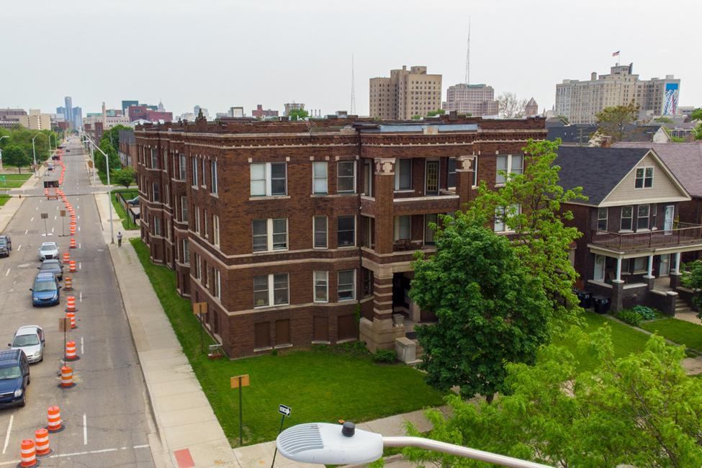
Accomplishments through August 2021
$2.9M Total Development Cost
$2.46M DHFF Senior Loan
7% of units at or <50% AMI
55% of units at or <60% AMI
38% of units at or <80% AMI
Added Energy Efficiencies

Slide 10
Eligible Project Types
New Multi-Family (Mixed-Income & Affordable)*
Preservation of Existing Regulated Affordable
Preservation of NOAH Buildings
Supportive Housing for Detroiters Experiencing Chronic Homelessness
*Multi-family target areas only

Slide 11
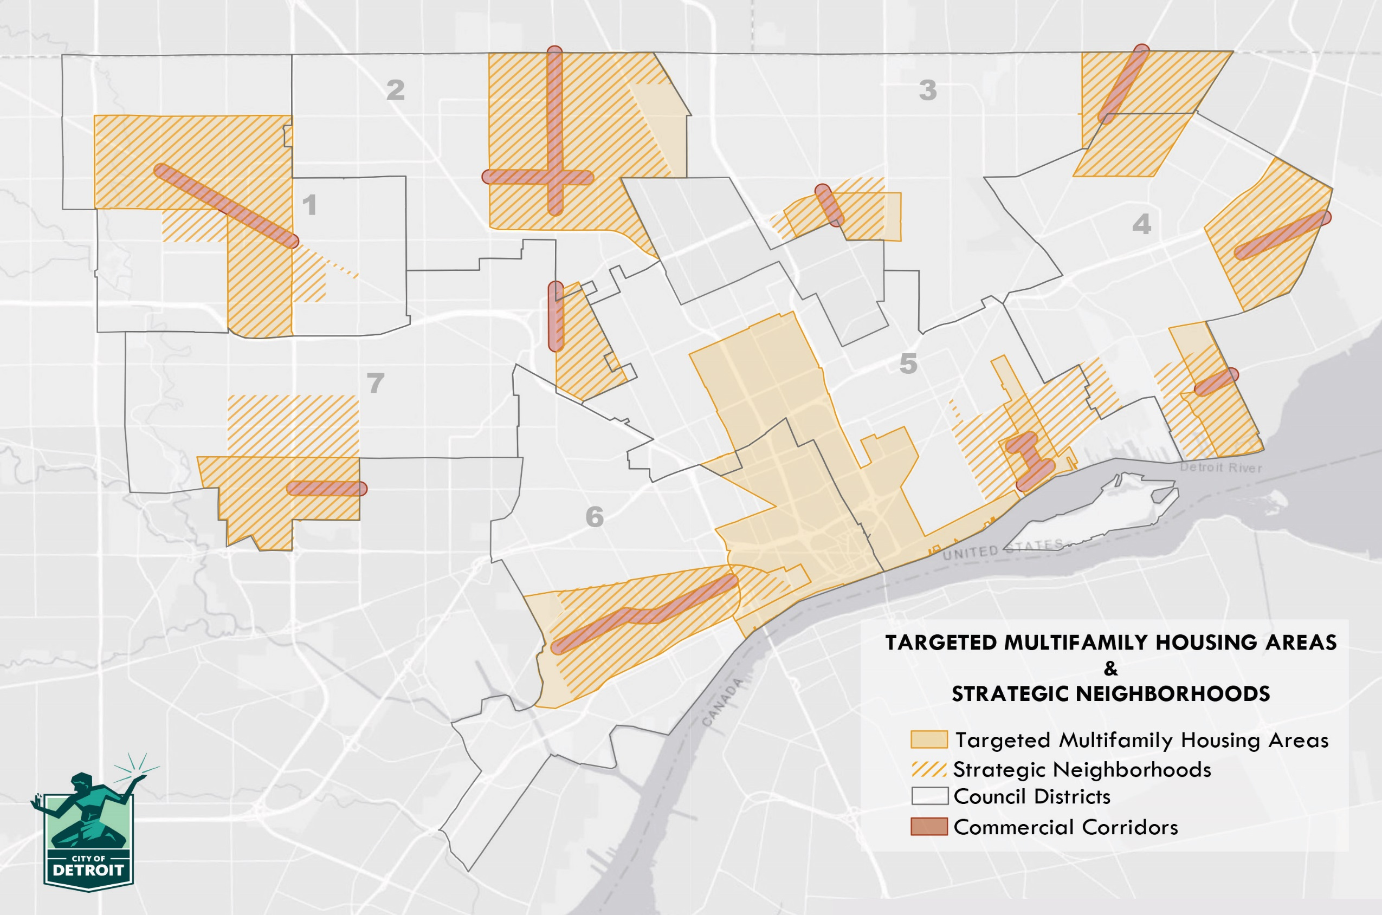

Slide 12
Detroit Housing for the Future Fund
Product Overview

Slide 13
DHFF Products
Senior Loan
Subordinate Loan
Preferred Equity (PE)
Capital Needs Assessment Recoverable Grant
Developers of Color Predevelopment Matching Grant

Slide 14
Program Eligibility
Geography-properties must be within the Detroit city limits
Meets affordability requirements
Proof of Site Control/or evidence in process
Current on Taxes by closing or approved payment plan with Wayne County Treasurer’s Office

Slide 15
Loan Product General Parameters
Eligible borrowers
For-profit and nonprofit owners/sponsors of affordable housing
Small/newer owners/sponsors who are partnered with experienced development consultants
Encouraging deep affordability targeting
Minimum 5% developer equity for non-profit sponsor
Minimum 5-10% developer equity for for-profit

Slide 16
Loan Product General Parameters
Collateralized
Guarantees
Recourse where allowable
1% origination fee on loans
Legal fees reimbursable

Slide 17
Affordability Requirements
Senior/Subordinate Debt
At least 50% of units must be 80% AMI or below
Remaining 50% of units at 120% AMI or below
Deeper affordability strongly encouraged and will score higher
Deed restricted for a minimum period of the loan term
DHFF will preserve affordability for existing regulated projects

Slide 18
Senior Debt
Senior Loan up to $5 million at 3% with a 14 year term including construction, up to 30 year amortization period
Construction/Mini Permanent debt
Allows for acquisition or refinancing existing debt
Moderate to substantial rehab based on per unit cost
Limited number of new unit construction projects
LTV up to 85%
Monthly interest payments during construction 1 year interest-only
Monthly Principal & Interest payments during remaining term
Refinance of outstanding principal at maturity
DSCR of 1.10x

Slide 19
Subordinate Debt
Subordinate Loan up to $2 million at 3% with a 14 year term including construction, up to 30 year amortization period
Construction/Mini Permanent debt
Allows for acquisition or refinancing existing debt
Moderate to substantial rehab based on per unit cost
Limited number of new unit construction projects
LTV up to 95%
Monthly interest payments during construction 1 year interest-only
Monthly Principal & Interest payments during remaining term
Refinance of outstanding principal at maturity
DSCR 1.05x

Slide 20
Preferred Equity Product General Parameters
Eligible borrowers
For-profit and nonprofit owners/sponsors of affordable housing within Detroit City limits
Small/newer owners/sponsors who are partnered with experienced development consultants
Product is an investment, not a grant
Encouraging deep affordability targeting
Minimum 5% developer equity in addition to the PE for non-profits
Minimum 5-10% developer equity in addition to the PE for for-profits
Guarantees/Recourse--N/A
1% origination fee on investments
Legal fees reimbursable

Slide 21
Preferred Equity Product
Maximum of up to $2 million for up to 25 year term
Small multifamily properties
Acquisition of existing buildings and may consider new construction
Refinancing existing debt
Moderate to substantial rehab based on per unit cost
LTV up to 120% combined debt in project
Operating Agreement

Slide 22
Preferred Equity Product
Repayment
Based on Equity Multiple, not IRR
1% annual distributable cash flow
Senior on the refinance before developer cash flow

Slide 23
Affordability Requirements
Preferred Equity
50% of overall units should be 80% AMI or below
Minimum of 5% of units at 50% AMI or lower
Minimum of 15% of units at 60% AMI or lower
Deeper affordability strongly encouraged and will score higher
Deed restricted for a minimum of the period of investment term
DHFF will preserve affordability for existing regulated projects
Portion of commercial space in mixed use projects reserved for minority-led businesses/entrepreneurs (where applicable)

Slide 24
Capital Needs Assessment (CNA) & Green CNA Recoverable Grant Product
Cover costs of 3rd party CNA
100% Affordable (Preservation) or NOAH projects
Willing to preserve existing affordability at a minimum
Up to $25,000 at 2 year term (no interest)
Reimbursable
Fully repayable at point of construction financing closing
$250 fee
Will require smaller application package
Single family scattered site/clustered projects ARE eligible
DHFF can provide vendor recommendations

Slide 25
Developers of Color (DOC) Predevelopment Matching Grant Award
Limited Availability Grant funds set aside for developers of color
For Preservation projects, must preserve existing affordability at a minimum
Matching grant up to $100,000
Cover costs of predevelopment expenses
Eligible costs include but not limited to:
Architectural or engineering fees
Third party costs (appraisal, title, survey, environmental studies, etc.)
LIHTC or other financing application fees
Consultant
Legal Fees (excluding other lender’s fees)

Slide 26
Base Approval Requirements
Developer Credit
Organizational Capacity
Minimum of 3 Years Experience Related to the Project Type Being Developed
Solid Reputation in the Community and Among Financers
Strong Track Record Showing Positive Results as a Developer or Owner
Experienced Consultant/Team Engaged for Sponsors Not Meeting Criteria
Leadership and Staff Analysis
Borrower Financial Capacity
Liquidity Measures
Equity Requirements

Slide 27
Required Documentation for Review
For-Profit Sponsors Must Provide:
Statement of Financial Position/Balance Sheets
Statement of Activities/Income Statements
Personal Financial Statement
Partners with 20% interest or higher
others requested by DHFF
REO Schedule if (Applicable)
Credit Authorization

Slide 28
Required Documentation for Review
Non-Profits Sponsors Must Provide:
Statement of Financial Position/Balance Sheets
Statement of Activities/Income Statements
Statement of Cash Flows
Board Approved Budget for Current Fiscal Year/Income Statement
Projected Cash Flow for the Upcoming 24 Months

Slide 29
Process Overview for Developers Applying to the Detroit Housing for the Future Fund
Stage 1: Pre-Application
Application portal opens on website
Stage 2: Application
Applicant is granted access to full application through portal
Stage 3: Threshold Review & Scoring
DHFF conducts threshold review and scoring of applications
DHFF schedules meeting with applicant to discuss pre-application
Pre-applications submitted
Applicant submits full application & required documentation
Stage 4: Intake & Project Review
DHFF submits intake package to committee for review
Applicant can be denied at this stage; DHFF will follow-up
DHFF works with applicant to obtain the necessary documents required to close and fund the loan
Project review meeting with DHFF, City of Detroit and MSHDA
Stage 5: Underwriting and Approval
Stage 6: Closing & Monitoring
DHFF schedules the closing with applicant
After the closing, DHFF Asset Manager monitors the performance of the loan and tracks payments
Letter of Interest sent after approval
Commitment letter sent after approval
Notes:
Pre-Application portal will be open year round
Meeting with developers in the pre-application stage is mandatory
Full applications accepted upon pre-application approval

Slide 30
Application Process
Pre-Application Submitted through Portal
One Pre-Application for use with all products
Application w/ Executive Summary
S&U
Proforma
Discussion with DHFF staff
Full Application Submitted through Portal
Upon approval of pre-application
Larger Checklist

Slide 31
Scoring & Underwriting
Threshold Review
Scoring
Intake Committee
Project Review Committee
Underwriting
Approval
Closing

Slide 32
DHFF Outreach
Informational Session 2021, future rounds
Outreach Sessions and Opportunities
Detroit Housing for the Future Fund Informational Webinars:
September
December

Slide 33
DHFF Portal Steps
https://www.detroithousingforthefuturefund.org/
https://www.detroithousingforthefuturefund.org/apply
Start a new application
https://apply.detroithousingforthefuturefund.org/signup
Apply Now Button

Slide 34
Victor Abla
Detroit LISC Regional Preservation Director
vabla@lisc.org
313-265-2893 (connects to mobile phone)
www.lisc.org/Detroit/
Brandon Ivory
LISC DHFF Loan Officer
bivory@lisc.org
313-265-2890 (connects to mobile phone)
www.lisc.org/Detroit/
www.detroithousingforthefuturefund.org
Webinars and slides will be archived on the website

Slide 35
Questions

